Slide 1
Self Project
WIFI-ROUTER PLACEMENT
Project by – Aman kumar

Slide 2
Motivation
Who doesn't love wireless Internet?
Millions of people rely on it for productivity and fun in countless cafes, railway stations and public areas of all sorts- For many institutions, ensuring wireless Internet access is now almost as important a feature of building facilities as the access to water and electricity-
Typically, buildings are connected to the Internet using a fiber backbone. In order to provide wireless Internet access, wireless routers are placed around the building and connected using fiber cables to the backbone. The larger and more complex the building, the harder it is to pick router locations and decide how to lay down the connecting cables.

Slide 3
The Formal
Statement
Let us represent a building using a 2-D matrix in which each cell is one of the following :
1- Wall cell (or any other obstruction) , represented as “#” ,an important feature of the wall cell is that it weakens the network by a fixed amount (heavy/big obstacles can be represented by multiple “#” ); also we cannot put a router in the wall cell.
2- Target cell, represented as “*” :- these are cells in which we need to have wireless coverage(for instance, in some classroom or office cabinet where internet is a necessity).
3- Void cell, represented as “-” :- these are cells in which we don’t need to have wireless coverage but routers can be put in void cells to provide network to ‘*’ cells if it is optimal.
We place a router at any grid such that the signal strength decreases as we move away from the router in each direction. Hence, after a certain distance S the signal strength becomes negligible and so the router doesn’t cover that part.
Budget : Connecting a single router costs some money. We are given a budget B and have to optimally reach the maximum number of asterisk(target cell) in the matrix.

Slide 4
Problem Description
Input:
The user is asked to enter two integers: n(rows) and m(columns) of the 2-D space.
Enter a matrix of dimension nxm as described in the problem statement.
Enter the budget:
B -> Budget of the programme i.e. we cannot exceed this amount while placing the routers.
Enter the Cost:
C -> cost of installation and manufacture of a single piece of WIFI-router.
Enter the Signal Strength:
S -> signal strength of routers to be installed

Slide 5
Problem Description
Output:
The first line of output consists of the ith router installed (If there are n routers to be installed, Router No.=1 represent the first, Router No.=2 the second and so on upto n).
The second line of output consists of the number of points that the router at ith position covers(for instance , if the 1st installed router can cover 10 ‘*’ points, we output mx:10)
The next line contains the specific cell coordinates where we have placed the ith optimal router(if we have placed the ith router in (a,b) we output x:a, y:b).
The next n lines have m integers each representing the matrix such that we mark all the visited nodes with ‘1’ and the unvisited nodes using a ‘0’.
We will learn more about this on the next slides using some examples.
Note: Each of the ith router details are separated by a delimiter.

Slide 6
Use of BFS in a 2-D grid for the solution
IN A GENERAL BFS ON A 2-D GRID :
If we apply BFS i.e Breadth First Search starting at a node ( i, j ) in a 2-dimensional matrix, then the traversal (in the order of Top-Right-Bottom-Left denoted as TRBL) will be as follows:
The current node will be marked visited and all the nodes around ( i, j) will be visited and enqueued if they are valid based upon the condition for validation.
Then all the nodes enqueued will be popped out and their TRBL neighbours will be visited.
So, starting from the root cell (i, j) we will go on traversing the cells around it in order of increasing distance from the root cell thus making it ideal for our problem as when a router will be placed at a point then the signal strength will drop as we move away from the root and will finally be negligible after a given distance S(which is specified as the strength of a router in our problem).

Slide 7
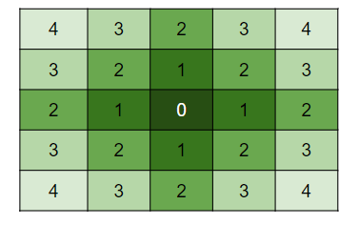
Visualizing the BFS action (discussed in previous slide):
The below image represents the order in which the cells will be visited if BFS is applied at the center of the grid.
In our algorithm we will be applying BFS at non-obstacle points that is at both ‘ * ’ and ‘ - ‘ to check for optimal conditions.

Slide 8
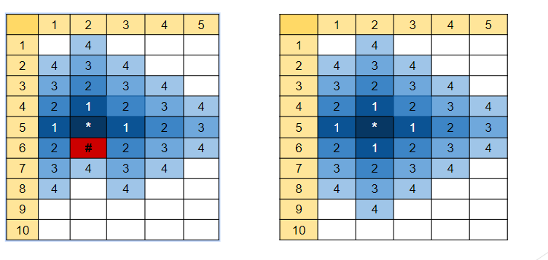
BFS also takes care of the weakening of signal strength due to an obstacle !!
The below image represents what will happen if we apply BFS at the “*” (5, 2) point in the given matrix.
As we can see that in the left we have an obstacle and on the right we don’t and on left the signal only reaches till (7,2) while it reaches till (9,2).

Slide 9
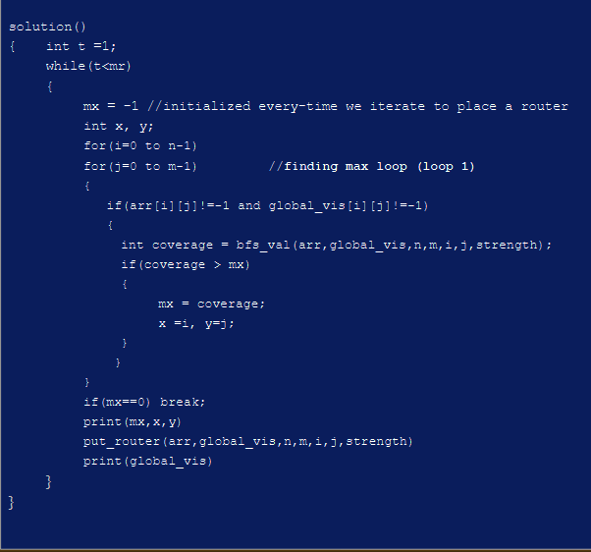
PseudoCode:
Let arr = modified input array where “*” is replaced by 1 , “ - ” by 0 and a wall i.e. “#” by -1.
B : Given budget, cost : cost of one router => Maximum no. of routers which can be placed i.e. mr = B/cost;
global_vis[n][m] : it is a globally used array defined in the main function which after each iteration of the loop 1 applies BFS to the most optimal (x,y) position and marks the areas covered by this router (x,y) as 1.
bfs_val() : It is the function which applies BFS to each point (i,j) in the matrix and returns the position where the coverage will be maximum if a router is placed (described in next slide).
put_router() : This function places the router at the optimal place (x,y) returned by the bfs_val() and marks the area covered by this router in the global_vis array (this function is also described in further slides).

Slide 10
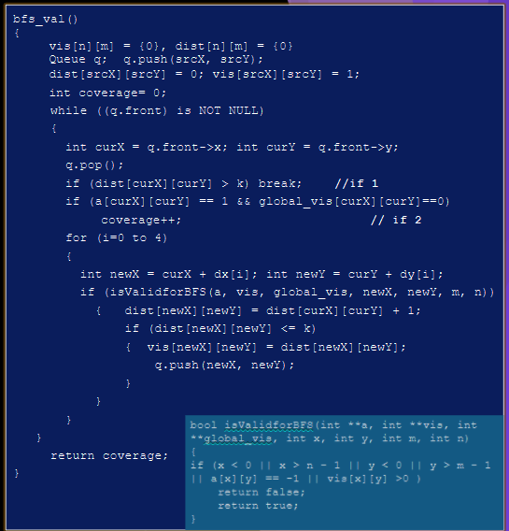
bfs_val():
Here vis[n][m] is a nxm local matrix which stores the visited index while applying BFS.
Queue q : q is a queue data structure which is implemented by C++ code(no library function used) it stores . Each node of a queue here stores the x,y coordinates and the pointer to the next node.
srcX and srcY are th coordinates (i,j) passed from the loop 1 in the solution function discussed previously.
curX, curY : these are the current indices which we are checking.
isValidforBFS() : returns true if (curX,curY) is not already visited in the BFS and if it lies inside the bounds (nxm) of the matrix.
Apart from basic BFS implementation, bfs_val() also stores the distance we have moved away from the source (srcX, srcY) so that we don’t go beyond the strength “k” of the router. The distance of a point is stored in the dist[n][m] array.
In “if 1” if we move away by more than k distance we stop.
“coverage” : It stores the number of “*” or “1” which we will cover by applying bfs at (srcX, srcY).
In “if 2” we increment the value of “coverage” if we have a “*” i.e. a “1” at that point which is not covered previously(information about the already covered points is stored in global_vis array from which it can be checked).

Slide 11
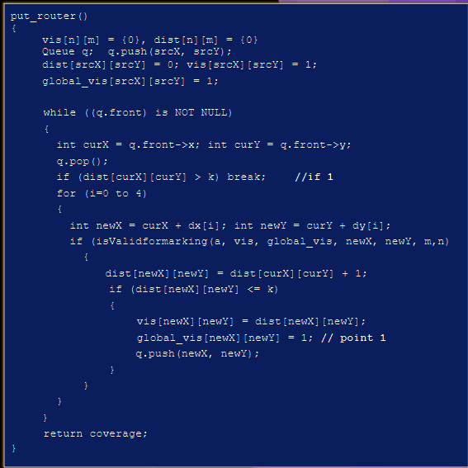
put_router():
Here vis[n][m] is a nxm local matrix which stores the visited index while applying BFS.
Queue q : q is a queue data structure which is implemented by C++ code(no library function used) it stores . Each node of a queue here stores the x,y coordinates and the pointer to the next node.
srcX and srcY are th coordinates (i,j) passed from the loop 1 in the solution function discussed previously.
curX, curY : these are the current indices which we are checking.
isValidformarking() : returns true if (curX,curY) is not already visited in the BFS and if it lies inside the bounds (nxm) of the matrix.
In “if 1” if we move away by more than k distance we stop.
Finally in point 1, we can see that if we put the router at (curX, curY) then it should be marked visited in the global visited array.

Slide 12
Test Case #1
Input:
Enter matrix dimensions : 5 5
Enter Matrix:
- * - * -
- - * * -
- - * - *
* - - * -
- * - - *
Enter Budget : 20
Enter cost : 9
Enter signal strength : 2

Slide 13
Test Case #1(contd.)
Output:
Router No. : 1
Points covered: 6
x : 1, y : 3
global_visited :
0 0 1 1 1
0 1 1 1 1
0 0 1 1 1
0 0 0 1 0
0 0 0 0 0
Output(contd.):
Router No. : 2
Points covered: 3
x : 2, y : 1
global_visited :
0 1 1 1 1
1 1 1 1 1
1 1 1 1 1
1 1 1 1 0
0 1 0 0 0

Slide 14
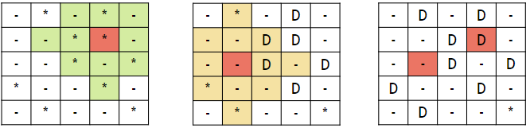
Test Case #1(contd.)
The first representation of our 2-D matrix shows the extent of signal strength if we place our router in (1,3). We also notice that it is the best choice as it can cover 6 necessary places(represented by asterisk). We have placed our first router there with cost of 9. Since our budget is 20, we can still place another router.
The second representation shows the extent of signal strength if we place our router in (2,1). We notice that it covers 3 of the last 4 essential places. Therefore we now have two routers placed in the best possible positions and our total cost is 18 which is within our budget. There is just one point left now at (4,4) where we could have placed another router but our budget does not allow that.
Note: The red cells denote a WIFI- router in that position and D cells denote that those necessary points have been taken care of.

Slide 15
Test Case #2
Input:
Enter Matrix Dimensions: 6 8
Enter Matrix:
- - * * * - - #
# * * * - - # #
* * * * * - - -
- - # * * - * *
* * * * * * * *
* - * - * - # -
Enter Budget: 1000
Enter cost: 200
Enter Signal Strength:2

Slide 16
Test Case #2(contd.)
Output:
Router No. : 1
Points Covered : 10
x : 1, y : 3
global_visited :
0 0 1 1 1 0 0 0
0 1 1 1 1 1 0 0
0 0 1 1 1 0 0 0
0 0 0 1 0 0 0 0
0 0 0 0 0 0 0 0
0 0 0 0 0 0 0 0
Output(contd.):
Router No. : 2
Points Covered : 8
x : 4, y : 3
global_visited :
0 0 1 1 1 0 0 0
0 1 1 1 1 1 0 0
0 0 1 1 1 0 0 0
0 0 0 1 1 0 0 0
0 1 1 1 1 1 0 0
0 0 1 1 1 0 0 0

Slide 17
Test Case #2(contd.)
Output(contd.):
Router No. : 4
Points Covered : 4
x : 3, y : 6
global_visited :
0 0 1 1 1 0 0 0
0 1 1 1 1 1 0 0
1 1 1 1 1 1 1 1
1 1 0 1 1 1 1 1
1 1 1 1 1 1 1 1
1 0 1 1 1 0 0 0
-----------------------------------
Router No. : 5
No need of this router as all coverage points already covered.
Output(contd.):
Router No. : 3
Points Covered : 4
x : 3, y : 0
global_visited :
0 0 1 1 1 0 0 0
0 1 1 1 1 1 0 0
1 1 1 1 1 0 0 0
1 1 0 1 1 0 0 0
1 1 1 1 1 1 0 0
1 0 1 1 1 0 0 0

Slide 18
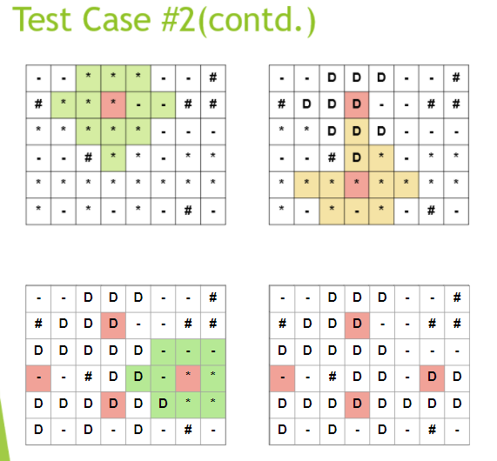
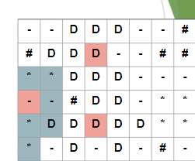

Slide 19
Test Case #2(contd.)
Explanation:
The first representation of our 2-D matrix shows the extent of signal strength if we place our router in (1,3). We also notice that it is the best choice as it can cover 10 necessary places(represented by asterisk). We have placed our first router there with cost of 200. Since our budget is 1000, we can still place 4 more routers.
The second representation shows the extent of signal strength if we place our router in (4,3). We notice that it covers 8 essential points. We also visualize that the signal points do not cover (3,2) since there is a wall cell. Therefore we now have two routers placed in the best possible positions, we have covered 18 points and our total cost is still 400 meaning that there is budget for more routers. We have 8 more points to cover.
The third representation shows the extent of signal strength if we place our router in (3,0). We notice that it covers 4 essential points. Here also, we can see that the cells (3,2) and (1,0) do not receive any network from this router because of the wall cells. Therefore we now have three routers placed in the best possible positions, we have covered 22 points and our total cost of 600 is also within the budget. We have just 4 more points to cover.

Slide 20
Test Case #2(contd.)
Explanation(contd.):
The fourth and last representation of our 2-D matrix shows the extent of signal strength if we place our router in (3,6). We notice that it covers 4 essential points. We also visualize that the signal points do not cover (1,6) and (5,6) since there is a wall cell. Therefore, we now have four routers placed in the best possible positions and we have covered all the 26 essential points of the matrix using just 800 which is less than our total cost of 1000.
We do not need to traverse any further since our entire asterisk points are covered within the budget. We can also see that in our final matrix photo that all the asterisk cells have been converted to ‘D’ cells.
Note: The red cells denote a WIFI- router in that position and D cells denote that those necessary points have been taken care of.

Slide 21
Thank You !

